Slide 1
TCP Congestion Control
TCP congestion control is a crucial mechanism used to manage the flow of data in a network and prevent congestion collapse, which can occur when too many packets are sent too quickly, overwhelming the network's capacity.
The first step in managing congestion is detecting it. Most transmission timeouts on the Internet are due to congestion.
A timeout caused by a lost packet could have been caused by either (1) noise on a transmission line or (2) packet discard at a congested router.
When a connection is established, a suitable window size has to be chosen. The receiver can specify a window based on its buffer size.
If the sender sticks to this window size, problems will not occur due to buffer overflow at the receiving end, but they may still occur due to internal congestion within the network.

Slide 2
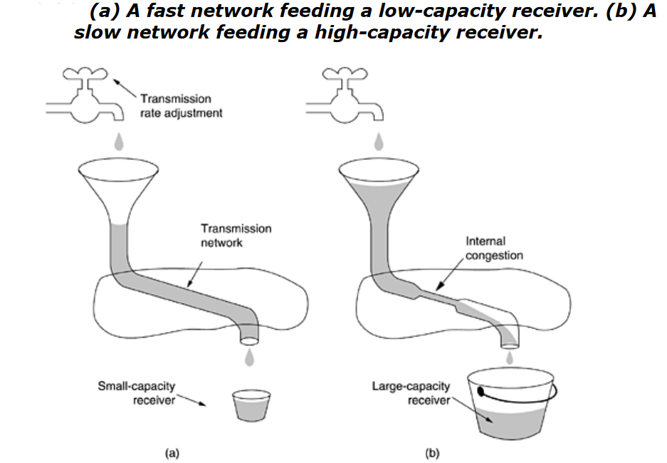
TCP Congestion Control
A thick pipe leading to a small-capacity receiver. As long as the sender does not send more water than the bucket can contain, no water will be lost.
The limiting factor is not the bucket capacity, but the internal carrying capacity of the network.
If too much water comes in too fast, it will back up and some will be lost.

Slide 3
TCP Congestion Control
Key Components
Congestion Window (cwnd):
The size of the congestion window determines how much data can be sent before receiving an acknowledgment (ACK) from the receiver. This window size is adjusted based on network conditions.
Slow Start:
When a TCP connection begins, the congestion window starts with a small size (usually one or two Maximum Segment Sizes, MSS). With each ACK received, the window size increases exponentially, doubling roughly every round-trip time (RTT). This phase continues until a threshold (ssthresh) is reached.
Slow Start is an essential part of TCP's congestion control strategy. It starts with a small congestion window, grows it exponentially with each round-trip time (RTT) as long as no congestion is detected, and then switches to a more gradual growth mode to manage congestion more effectively.
This approach helps to find the optimal data rate while maintaining network stability and fairness.

Slide 4
TCP Congestion Control
Congestion Avoidance :
Congestion Avoidance is a crucial phase of TCP’s congestion control mechanism, designed to carefully manage the data transfer rate to avoid network congestion.
It achieves this by transitioning from the exponential growth of Slow Start to a more controlled, linear growth of the congestion window. This approach helps maintain network stability and fairness, adapting to the network’s capacity while responding appropriately to congestion events.
After reaching the ssthresh, TCP switches to a linear increase in the congestion window size. This means the window grows more slowly (typically by one MSS per RTT) to avoid overwhelming the network.
In Congestion Avoidance, the growth of the congestion window is linear rather than exponential. This means that for every round-trip time (RTT), the cwnd increases by a fixed amount, usually one MSS (Maximum Segment Size).
The growth rate is typically calculated as: cwnd = cwnd+MSS^2​ / cwnd.
This formula ensures that as the window grows larger, the increase becomes smaller, allowing for more stable and controlled expansion of the sending rate.

Slide 5
TCP Congestion Control
Fast Retransmit and Fast Recovery:
If a packet is lost (detected by missing ACKs or receiving duplicate ACKs), TCP quickly retransmits the lost packet (fast retransmit) and enters the fast recovery phase.
During this phase, the congestion window is reduced to avoid further congestion but not to the initial size as in slow start.
Fast Retransmit: Quickly retransmits a lost packet upon receiving three duplicate ACKs, without waiting for a timeout. This reduces the delay in recovering from packet loss.
Fast Recovery: Manages the congestion window size more gracefully following a fast retransmit. It avoids the severe reduction in throughput that would occur with a timeout, maintaining better performance and quicker recovery.
Together, Fast Retransmit and Fast Recovery help TCP connections recover from packet loss more efficiently, minimizing disruption and maintaining higher throughput in the face of network congestion.

Slide 6
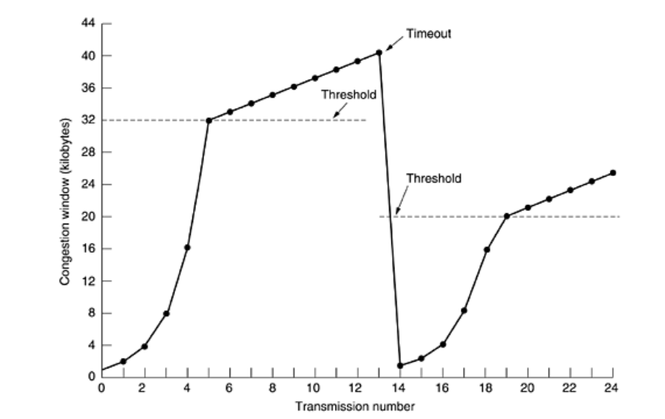
TCP Congestion Control
Timeouts:
If packets are lost and not recovered through duplicate ACKs, TCP will time out and perform a slow start to reduce the window size drastically, which helps in recovering from severe congestion.

Slide 7
TCP Congestion Control
The maximum segment size here is 1024 bytes. Initially, the congestion window was 64 KB, but a timeout occurred, so the threshold is set to 32 KB and the congestion window to 1 KB for transmission 0 here.
The congestion window then grows exponentially until it hits the threshold (32 KB). Starting then, it grows linearly.
Transmission 13 is unlucky (it should have known) and a timeout occurs. The threshold is set To half the current window (by now 40 KB, so half is 20 KB), and slow start is initiated all over again.
When the acknowledgements from transmission 14 start coming in, the first four each double the congestion window, but after that, growth becomes linear again.
If no more timeouts occur, the congestion window will continue to grow up to the size of the receiver's window. At that point, it will stop growing and remain constant as long as there are no more timeouts and the receiver's window does not change size.
As an aside, if an ICMP SOURCE QUENCH packet comes in and is passed to TCP, this event is treated the same way as a timeout.

Slide 8
TCP Timer Management
TCP uses multiple timers to do its work. The most important of these is the retransmission timer.
When a segment is sent, a retransmission timer is started. If the segment is acknowledged before the timer expires, the timer is stopped.
If, on the other hand, the timer goes off before the acknowledgement comes in, the segment is retransmitted (and the timer started again).
The question that arises is: How long should the timeout interval be? This problem is much more difficult in the Internet transport layer protocols.
The expected delay is highly predictable (i.e., has a low variance), so the timer can be set to go off just slightly after the acknowledgement is expected, as shown in Figure.
Since acknowledgements are rarely delayed in the data link layer (due to lack of congestion), the absence of an acknowledgement at the expected time generally means either the frame or the acknowledgement has been lost.

Slide 9
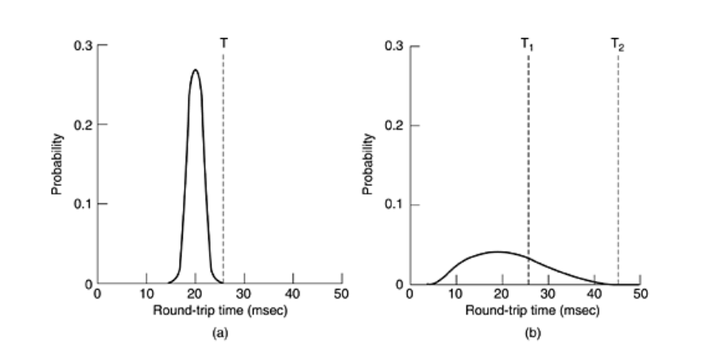
TCP Timer Management
Probability density of acknowledgement arrival times in the data link layer. (b) Probability density of
acknowledgement arrival times for TCP.

Slide 10
TCP Timer Management
TCP is faced with a radically different environment. The probability density function for the time it takes for a TCP acknowledgement to come back looks more like Fig.(b) than Fig. (a). Determining the round-trip time to the destination is tricky.
Even when it is known, deciding on the timeout interval is also difficult. If the timeout is set too short, say, T1 in Fig. (b), unnecessary retransmissions will occur, clogging the Internet with useless packets.
If it is set too long, (e.g., T 2), performance will suffer due to the long retransmission delay whenever a packet is lost.
Furthermore, the mean and variance of the acknowledgement arrival distribution can change rapidly within a few seconds as congestion builds up or is resolved.
The solution is to use a highly dynamic algorithm that constantly adjusts the timeout interval, based on continuous measurements of network performance.
The algorithm generally used by TCP is due to Jacobson (1988) and works as follows. For each connection, TCP maintains a variable, RTT, that is the best current estimate of the round-trip time to the destination in question.

Slide 11

TCP Timer Management
When a segment is sent, a timer is started, both to see how long the acknowledgement takes and to trigger a retransmission if it takes too long.
If the acknowledgement gets back before the timer expires, TCP measures how long the acknowledgement took, say, M.
It then updates RTT according to the formula where α is a smoothing factor that determines how much weight is given to the old value. Typically α = 7/8.
Even given a good value of RTT, choosing a suitable retransmission timeout is a nontrivial matter.
Normally, TCP uses βRTT, but the trick is choosing β. In the initial implementations, β was always 2, but experience showed that a constant value was inflexible because it failed to respond when the variance went up.
In 1988, Jacobson proposed making β roughly proportional to the standard deviation of the acknowledgement arrival time probability density function so that a large variance means a large β, and vice versa.

Slide 12


TCP Timer Management
In particular, he suggested using the mean deviation as a cheap estimator of the standard deviation. His algorithm requires keeping track of another smoothed variable, D, the deviation.
Whenever an acknowledgement comes in, the difference between the expected and observed values, | RTT - M |, is computed. smoothed value of this is maintained in D by the formula.
Where α may or may not be the same value used to smooth RTT. While D is not exactly the same as the standard deviation, it is good enough and Jacobson showed how it could be computed using only integer adds, subtracts, and shifts—a big plus.
Most TCP implementations now use this algorithm and set the timeout interval to
The choice of the factor 4 is somewhat arbitrary, but it has two advantages.
First, multiplication by 4 can be done with a single shift. Second, it minimizes unnecessary timeouts and retransmissions because less than 1 percent of all packets come in more than four standard deviations late.

Slide 13
TCP Timer Management
One problem that occurs with the dynamic estimation of RTT is what to do when a segment times out and is sent again.
When the acknowledgement comes in, it is unclear whether the acknowledgement refers to the first transmission or a later one.
Guessing wrong can seriously contaminate the estimate of RTT. Phil Karn discovered this problem the hard way. He is an amateur radio enthusiast interested in transmitting TCP/IP packets by ham radio, a notoriously unreliable medium.
He made a simple proposal: do not update RTT on any segments that have been retransmitted. Instead, the timeout is doubled on each failure until the segments get through the first time. This fix is called Karn's algorithm.
Most TCP implementations use it. The retransmission timer is not the only timer TCP uses. A second timer is the persistence timer.
It is designed to prevent the following deadlock. The receiver sends an acknowledgement with a window size of 0, telling the sender to wait.

Slide 14
TCP Timer Management
Karn's Algorithm is a technique used in TCP to improve the handling of retransmissions in the presence of network congestion. It addresses the issue of timeouts and retransmission timeouts, which can be problematic when packet loss occurs or when the round-trip time (RTT) estimation is inaccurate.
In TCP, when a packet is lost or suspected to be lost, the sender retransmits it. The retransmission timeout (RTO) is crucial because it determines how long the sender waits before assuming that the packet is lost and retransmitting it. The algorithm for calculating RTO involves estimating the RTT and its variability.
However, when a packet is retransmitted, it can complicate RTT measurements if the acknowledgment (ACK) for the original packet and its retransmission arrive around the same time.
Problem Addressed by Karn's Algorithm
RTT Estimation: When a packet is retransmitted, its RTT cannot be accurately measured because the ACKs received for the retransmitted packet may not reflect the current network conditions but rather the conditions from when the original packet was sent.
Ambiguity in RTT Measurement: If the original packet and its retransmission both generate ACKs, it can be unclear which ACK corresponds to which packet, leading to incorrect RTT measurements.

Slide 15
TCP Timer Management
The receiver updates the window, but the packet with the update is lost. Now both the sender and the receiver are waiting for each other to do something.
When the persistence timer goes off, the sender transmits a probe to the receiver. The response to the probe gives the window size. If it is still zero, the persistence timer is set again and the cycle repeats. If it is nonzero, data can now be sent.
A third timer that some implementations use is the keepalive timer. When a connection has been idle for a long time, the keepalive timer may go off to cause one side to check whether the other side is still there.
If it fails to respond, the connection is terminated. This feature is controversial because it adds overhead and may terminate an otherwise healthy connection due to a transient network partition.
The last timer used on each TCP connection is the one used in the TIMED WAIT state while closing. It runs for twice the maximum packet lifetime to make sure that when a connection is closed, all packets created by it have died off.

